Slide 1
Checking understanding of plotting coordinates
Plotting coordinates

Slide 2
how to use Oak lessons

Slide 3
I can plot coordinates in the first quadrant.

Slide 4
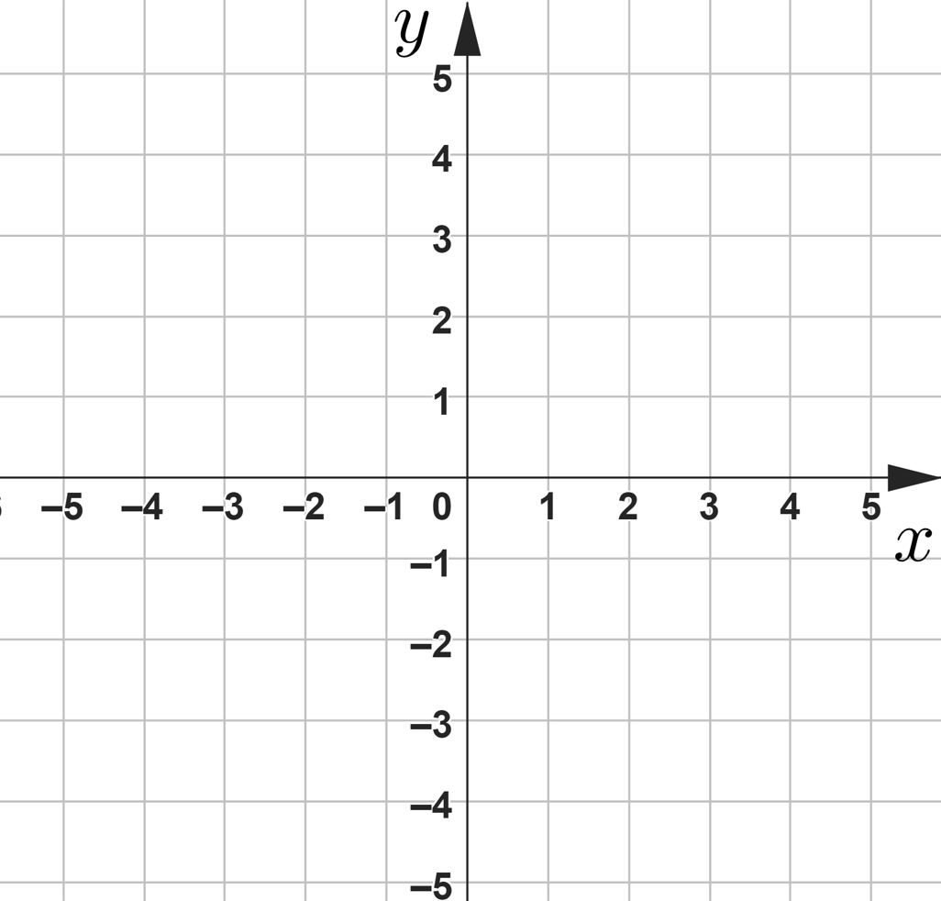
A quadrant is any one of the four areas into which a space is divided by the x and y axes in the Cartesian coordinate system.
Second quadrant
First quadrant
The origin is where the x - axis and y - axis cross. It has the coordinate pair (0,0).
Third quadrant
Fourth quadrant
Drawing on a graph or map is known as plotting.
To translate a shape is to perform a translation. A transformation in which every point of a shape moves the same distance in the same direction.

Slide 5

Checking understanding of plotting coordinates
Plotting coordinates in the first quadrant
Using coordinates to plot shapes
Translating shapes

Slide 6
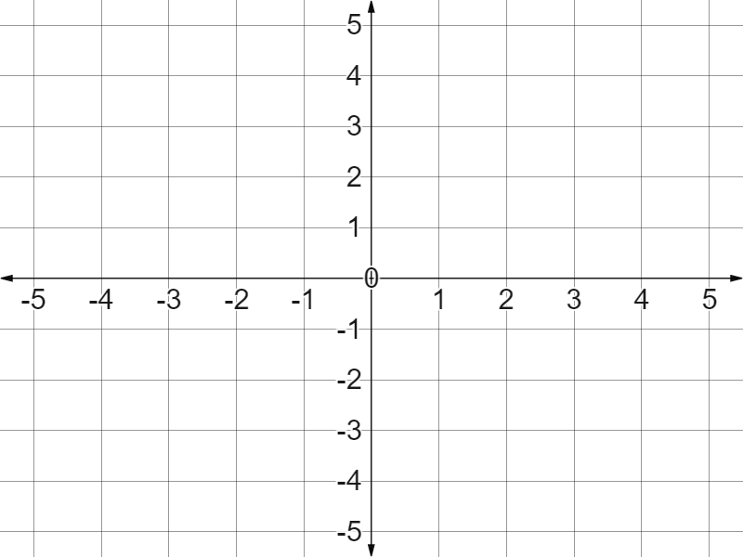
Plotting coordinates in the first quadrant
This is a Cartesian Coordinate Grid.
Can we label it with these key features?
The first quadrant
The x axis
Origin
✖
The y axis
The origin
(0,0)
The first quadrant

Slide 7
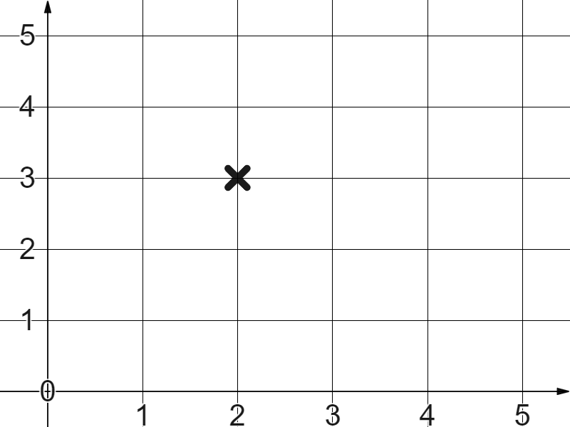
Plotting coordinates in the first quadrant
Coordinates are a system used to define the position of a point on a Cartesian Coordinate Grid.
Coordinates are a system used to define the position of a point on a Cartesian Coordinate Grid.
René Descartes (1596-1650)

Slide 8
Plotting coordinates in the first quadrant
What language would you use to describe this position?
“Two along, three up ?”
“Two right, three up ?”
“Two right, three up from the origin”
(0,0)
✖

Slide 9
Plotting coordinates in the first quadrant
Could you describe this position in a sentence using x and y?
“Two in the x direction, and three in the y direction”
“Two in the positive x direction, and three in the positive y direction from the origin”

Slide 10
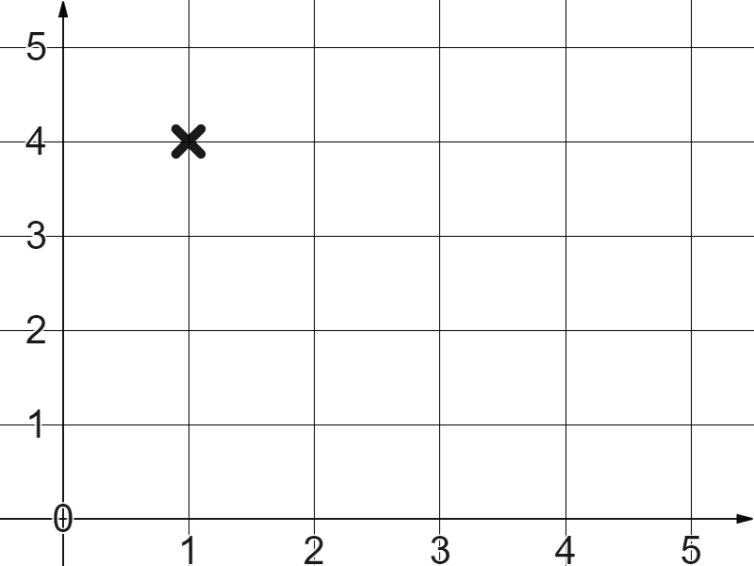

Plotting coordinates in the first quadrant
Which sentence best describes this coordinate?
One along, four up.
One in the x direction, four in the y direction.
Four in the x direction, one in the y direction.
One in the positive x direction, four in the positive y direction.

Slide 11

Plotting coordinates in the first quadrant
Could you describe this position in a sentence using x and y?
“The x coordinate is two,
“The x coordinate is two, the y coordinate is three”
(2, 3)
The x coordinate
The y coordinate

Slide 12
Plotting coordinates in the first quadrant
How do you correctly write a coordinate pair?
The x coordinate first, the y coordinate second.
(5, 2)
The x coordinate
The y coordinate
The x coordinate is second, the y coordinate first.
Either way. It doesn’t matter.

Slide 13
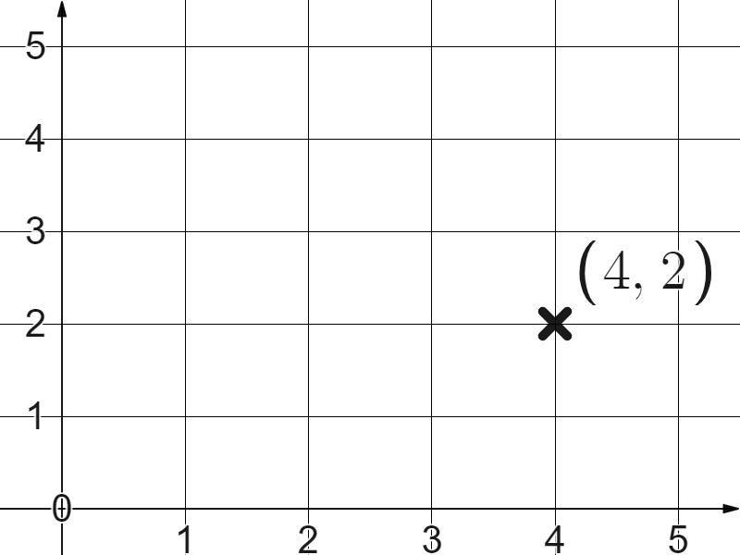
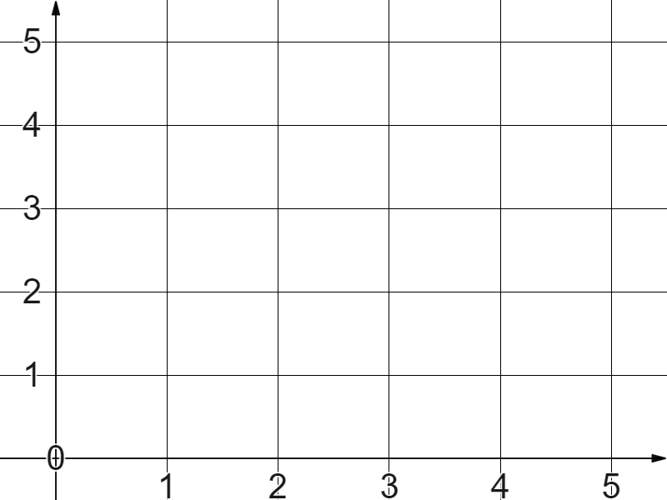
Plotting coordinates in the first quadrant
Plot the coordinate (4,2)
(4, 2)

Slide 14
Plotting coordinates in the first quadrant
Plot the coordinate (4,0)
Four in the positive x direction, zero in the positive y direction.
(4, 0)

Slide 15
Plotting coordinates in the first quadrant
What is the same, what is different, about these two coordinates?
5
Same:
They both have a 2 and a 5
2
Different:
The direction of the 2 and the 5
2
5

Slide 16
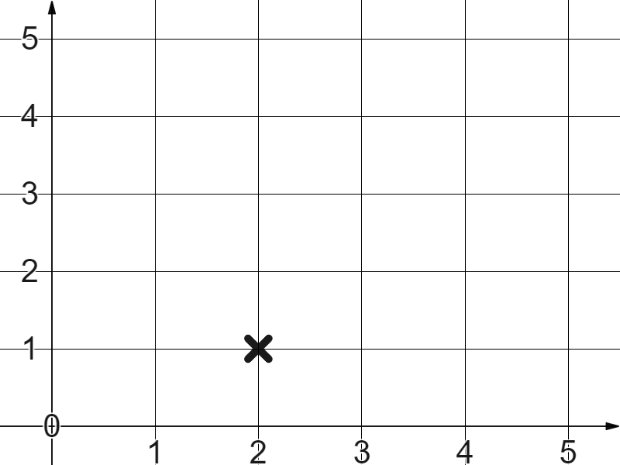
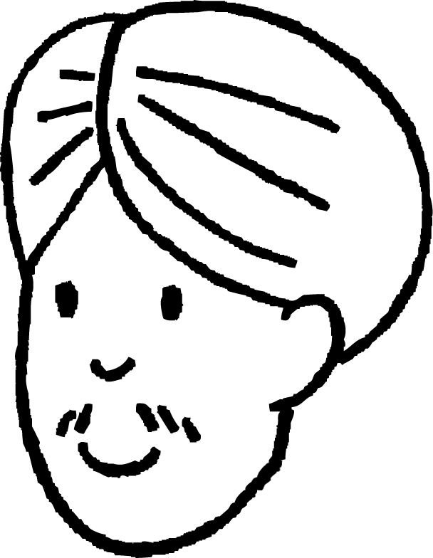
Plotting coordinates in the first quadrant
Andeep plots the coordinate (1,2)
What has he done wrong?
(1, 2)
He moved two in the x direction and one in the y direction accidentally plotting (2,1) instead.
(2, 1)

Slide 17
Plotting coordinates in the first quadrant
1) The coordinate (0,0) where the x and y axes cross is called the __________.
2) Plot these coordinates and label them:
(3,5)
(5,3)
(5,5)
(0,5)

Slide 18
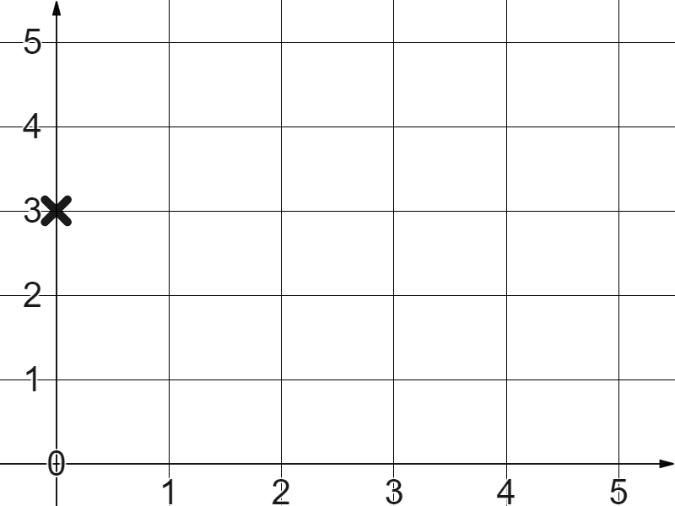
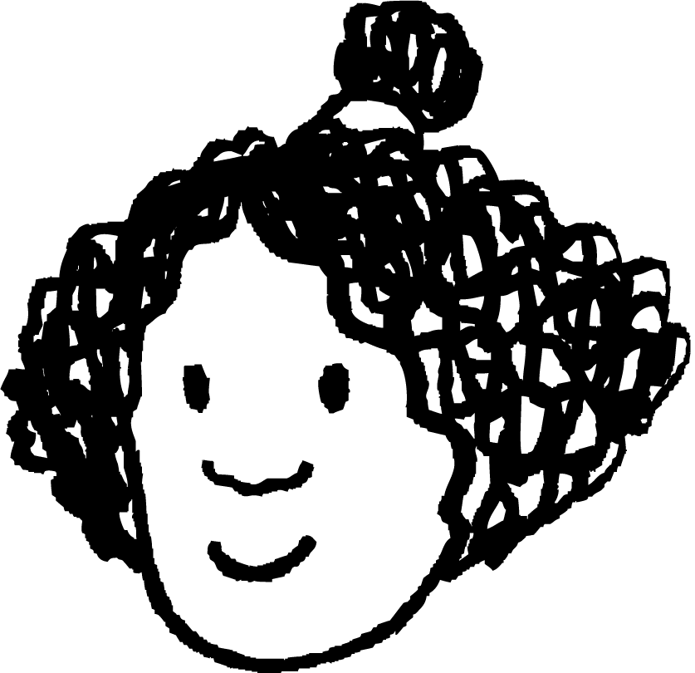
Plotting coordinates in the first quadrant
3) Izzy plots the coordinate (3,0).
Write a sentence to explain her error.

Slide 19
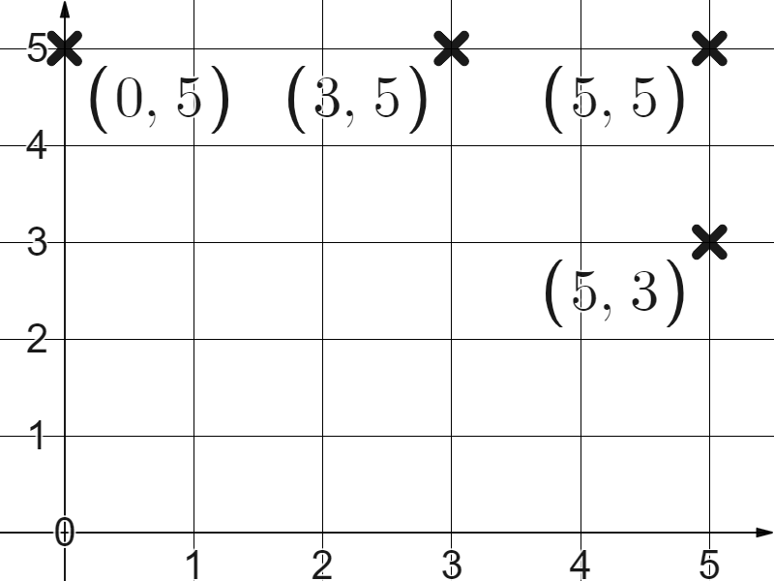
Plotting coordinates in the first quadrant
1) The coordinate (0,0) where the x and y axes cross is called the origin .
2) Plot these coordinates and label them:
(3,5)
(5,3)
(5,5)
(0,5)

Slide 20
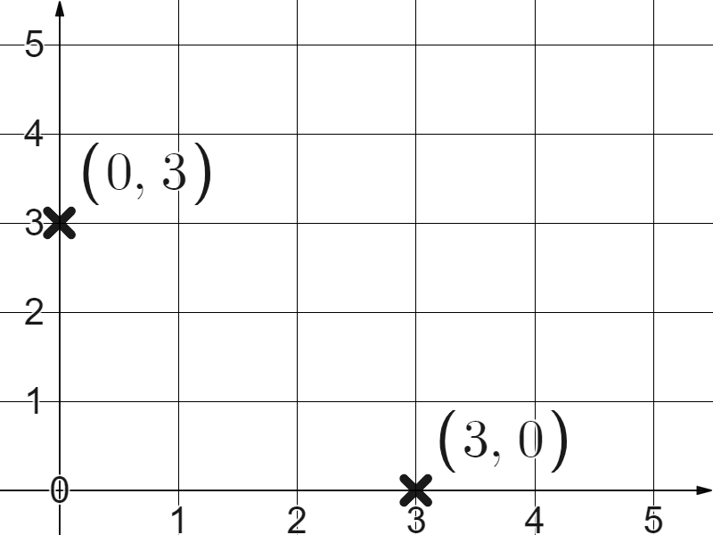
Plotting coordinates in the first quadrant
3) Izzy plots the coordinate (3,0).
Your sentence might have read, ‘(3,0) is three in the positive x direction, then zero in the positive y direction from the origin. Izzy did it the other way round’.

Slide 21
Checking understanding of plotting coordinates
Plotting coordinates in the first quadrant
Using coordinates to plot shapes
Translating shapes

Slide 22
Using coordinates to plot shapes
Plot these coordinates.
(1,4)
(1,1)
(4,1)
(4,4)
They form a square.

Slide 23
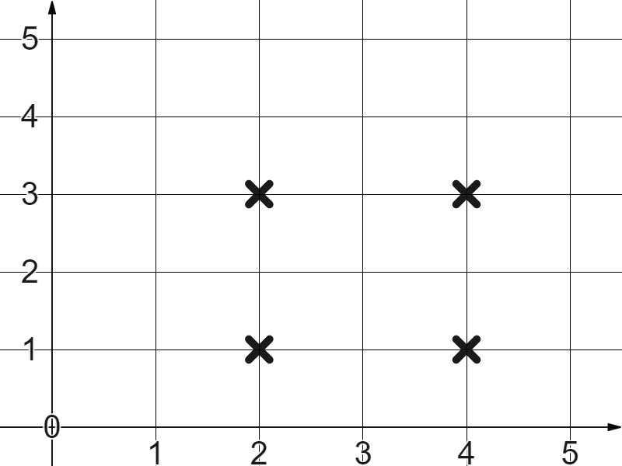
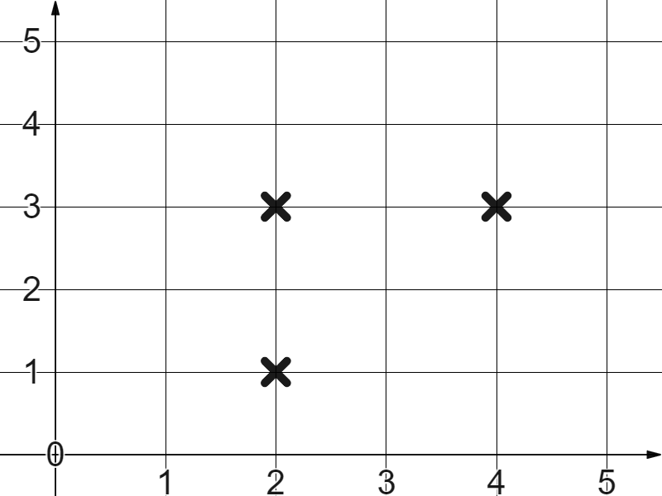
Using coordinates to plot shapes
Which additional coordinate do you need to plot to form a square?

Slide 24
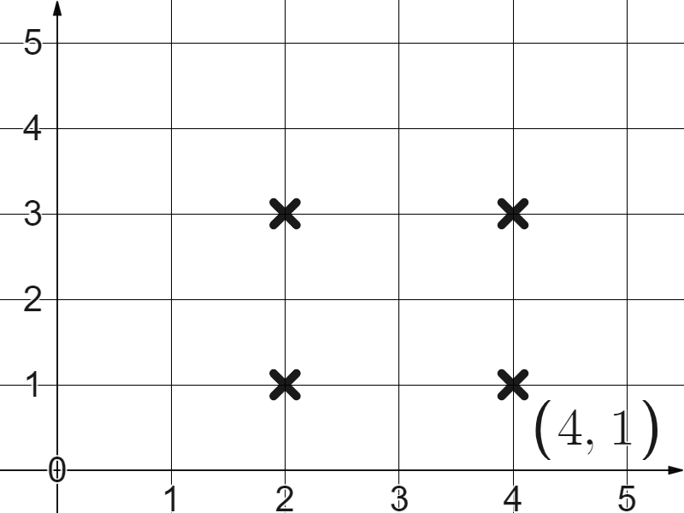
Using coordinates to plot shapes
Which additional coordinate do you need to plot to form a square?

Slide 25
Using coordinates to plot shapes
Plot these coordinates.
(2,1)
(4,3)
(2,5)
(0,3)
They also form a square, but a tilted one

Slide 26
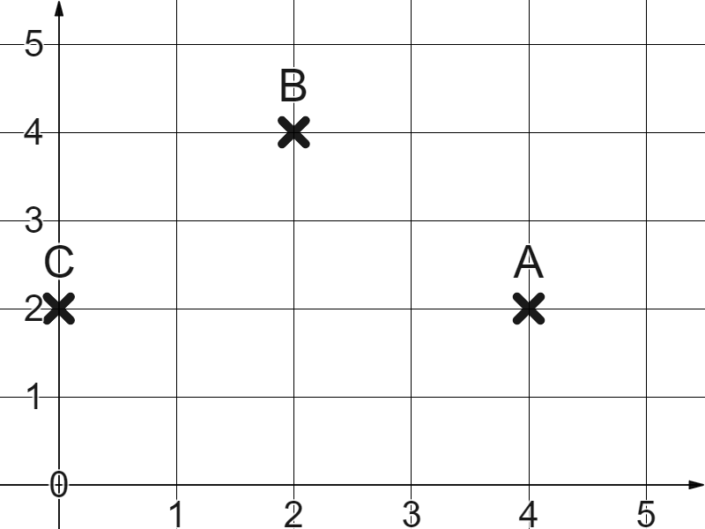
Using coordinates to plot shapes
Where should we plot point D to make sure ABCD forms a square?
We need to plot D at (2,0) in order to form a square.
D

Slide 27
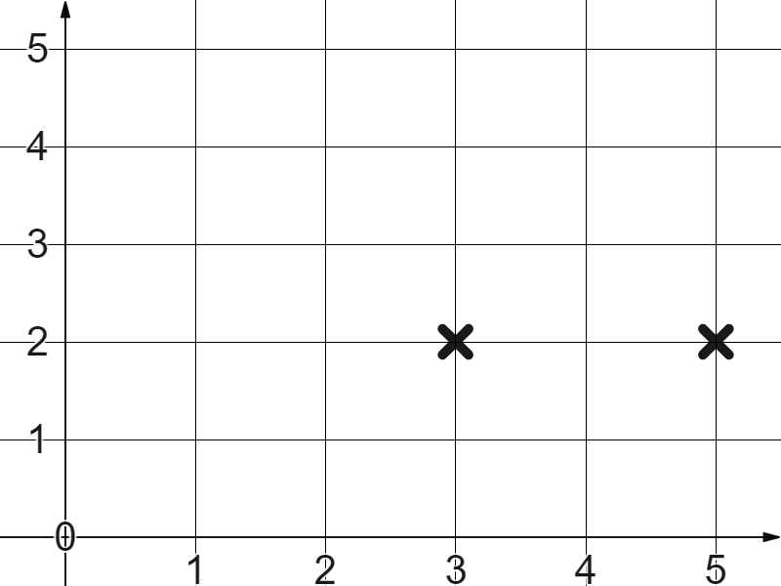
Using coordinates to plot shapes
1) The first two coordinates are (3,2) and (5,2)
Which other coordinate pairs would form a square?

Slide 28
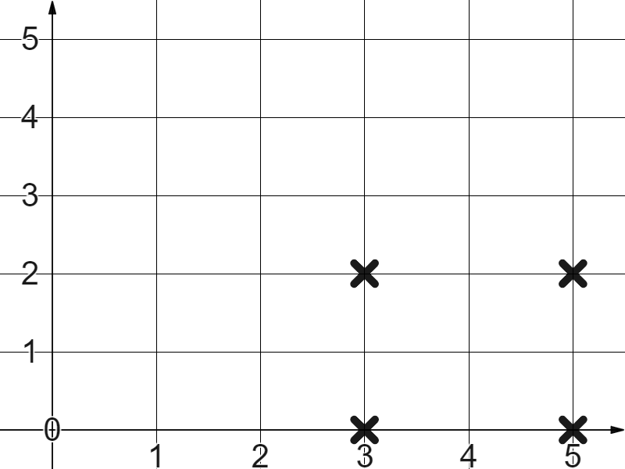
Using coordinates to plot shapes
1) The first two coordinates are (3,2) and (5,2)
Which other coordinate pairs would form a square?
(3,0) and (5,0) make a square.

Slide 29
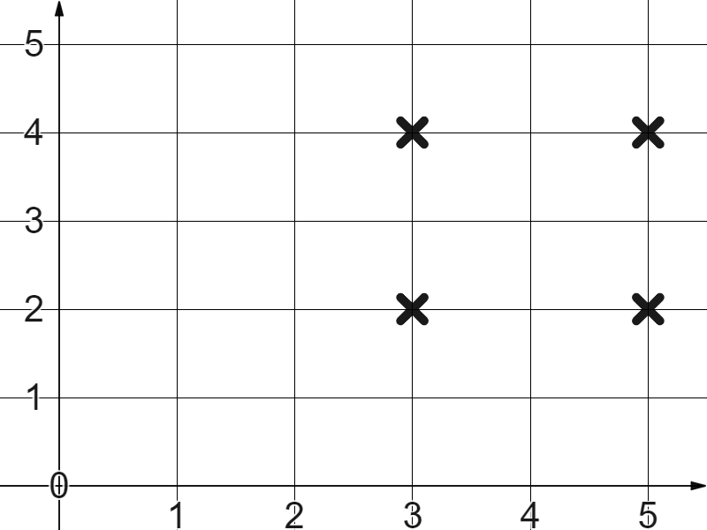
Using coordinates to plot shapes
1) The first two coordinates are (3,2) and (5,2)
Which other coordinate pairs would form a square?
(3,0) and (5,0) make a square.
(3,4) and (5,4) make a square.

Slide 30
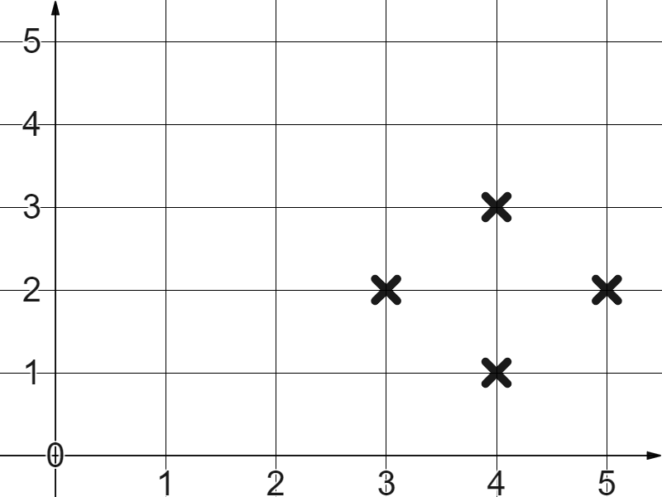
Using coordinates to plot shapes
1) The first two coordinates are (3,2) and (5,2)
Which other coordinate pairs would form a square?
(3,0) and (5,0) make a square.
(3,4) and (5,4) make a square.
(4,1) and (4,3) make a square.

Slide 31
Checking understanding of plotting coordinates
Plotting coordinates in the first quadrant
Using coordinates to plot shapes
Translating shapes

Slide 32
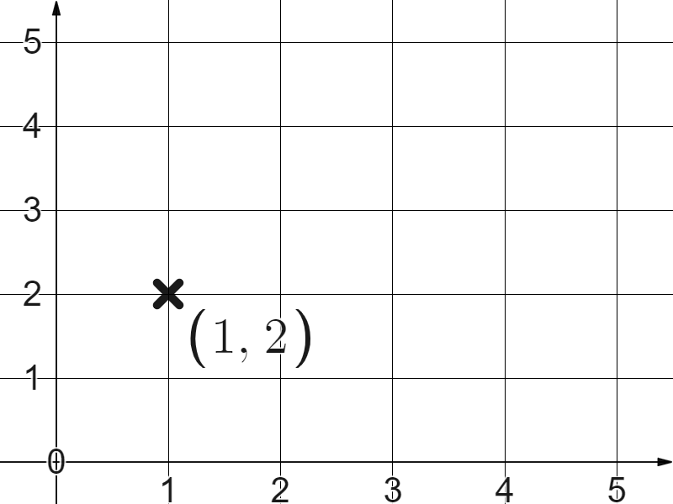
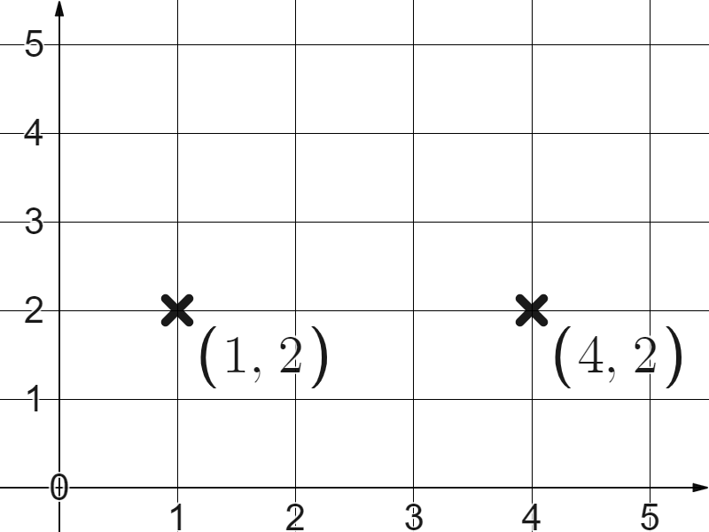
Translating shapes
What will happen if we add 3 to only the x coordinate?
We get the coordinate (4,2)
The point has translated three to the right, three in the positive x direction.

Slide 33
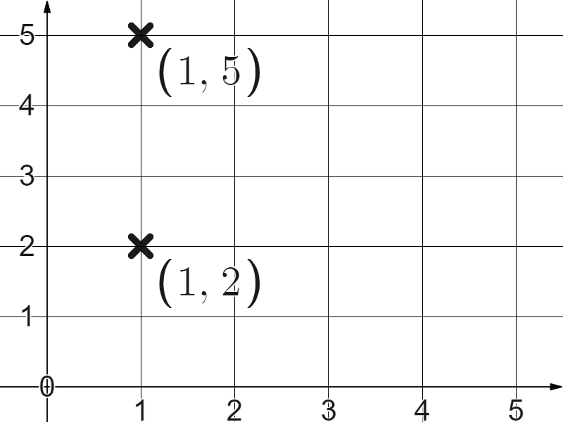
Translating shapes
What would happen if we added 3 to y coordinate instead?
We get the coordinate (1,5), a translation three up, three in the positive y direction.

Slide 34
Translating shapes
If we add positively to the value of the x coordinate a, point will translate in which direction?
The positive y direction
The positive x direction
Diagonally

Slide 35
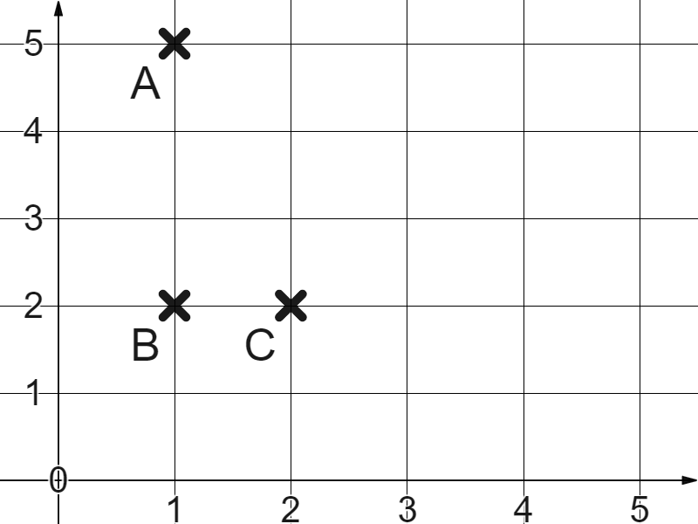
Translating shapes
Triangle ABC has the below coordinates.
A (1,5)
B (1,2)
C (2,2)
(4,5)
(4,2)
(5,2)
What happens if we add 3 to each x coordinate?

Slide 36
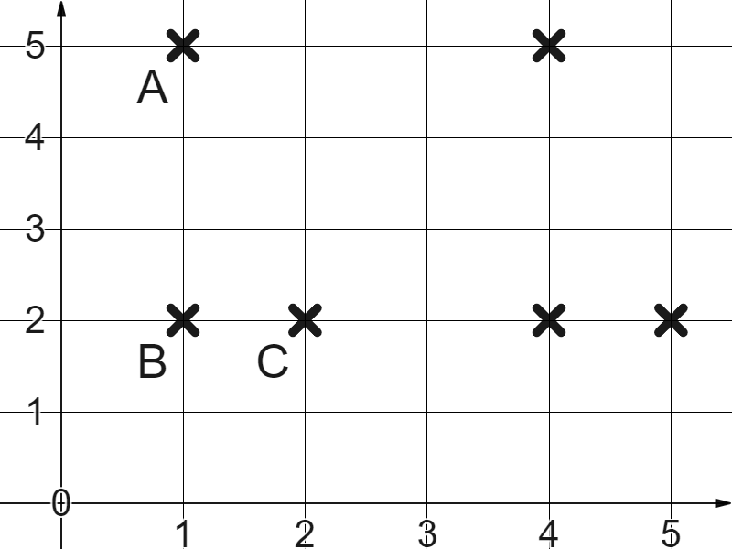
Translating shapes
Triangle ABC has the below coordinates.
A (1,5)
B (1,2)
C (2,2)
(4,5)
(4,2)
(5,2)
Translation by 3 in the positive x direction.

Slide 37
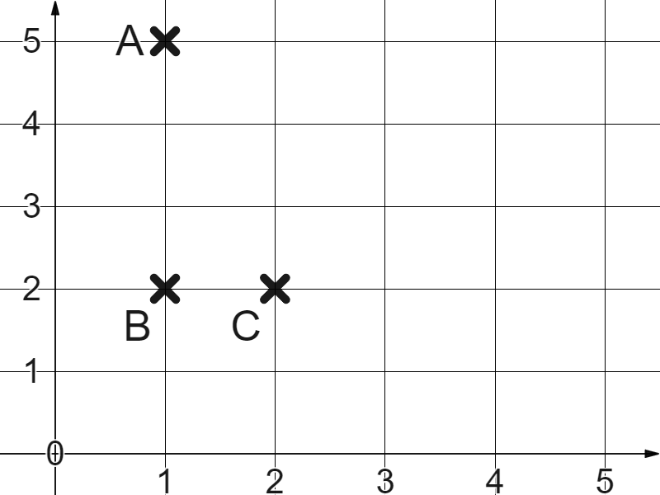
Translating shapes
Triangle ABC has the below coordinates.
A (1,5)
B (1,2)
C (2,2)
(1,5)
(4,2)
(5,2)
What if we don’t add three to all the x coordinates?

Slide 38
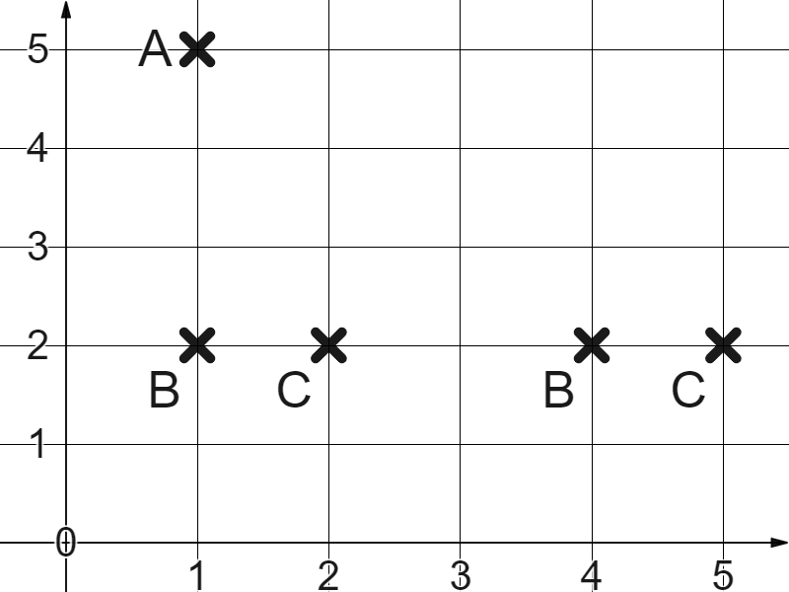
Translating shapes
Triangle ABC has the below coordinates.
A (1,5)
B (1,2)
C (2,2)
(1,5)
(4,2)
(5,2)
No longer a translation.
We have to change all points by the same rule.

Slide 39
Translating shapes
Changing all the coordinates of a shape will translate it.
Yes, because all the vertices will move.
Yes, but only if you follow the same rule for each coordinate.

Slide 40
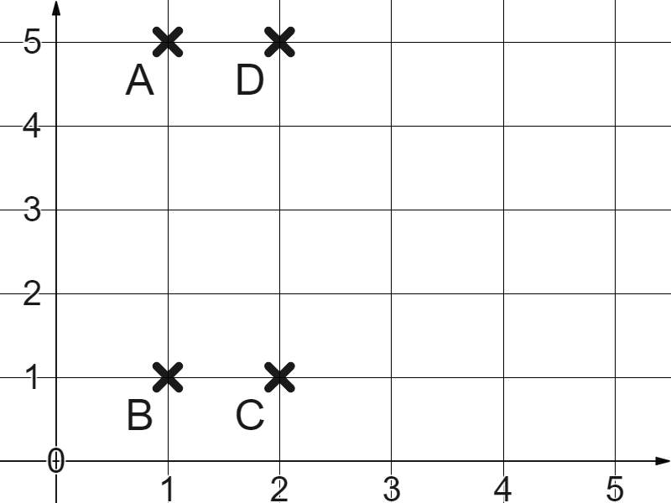
Translating shapes
1) Why will the below not create a translation of rectangle ABCD?
A (1,5)
B (1,1)
C (2,1)
D (2,5)
(4,5)
(3,1)
(5,1)
(5,5)

Slide 41
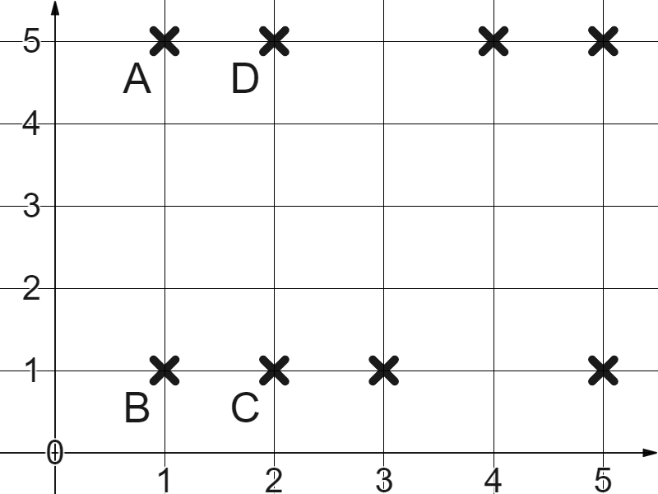
Translating shapes
1) Why will the below not create a translation of rectangle ABCD?
A (1,5)
B (1,1)
C (2,1)
D (2,5)
(4,5)
(3,1)
(5,1)
(5,5)
The four points did not all follow the same rule.

Slide 42
Checking understanding of plotting of coordinates
Coordinates can be plotted in the first quadrant by following the positive x direction and positive y direction from the origin.
Sets of points can be used to create shapes. Those shapes can be translated by applying the same rule to each coordinate.

Slide 43

© Oak National Academy 2023.
Produced in partnership with Mathematics in Education and Industry.
Licensed on the Open Government Licence v3.0, except where otherwise stated. See Oak terms and conditions.

